Slide 1
Introduction to Computer Hardware and Operating Systems Part 2
Bits, Bytes, and Everything Nice: Unpacking the Essentials of Computer Hardware and Operating Systems

Slide 2
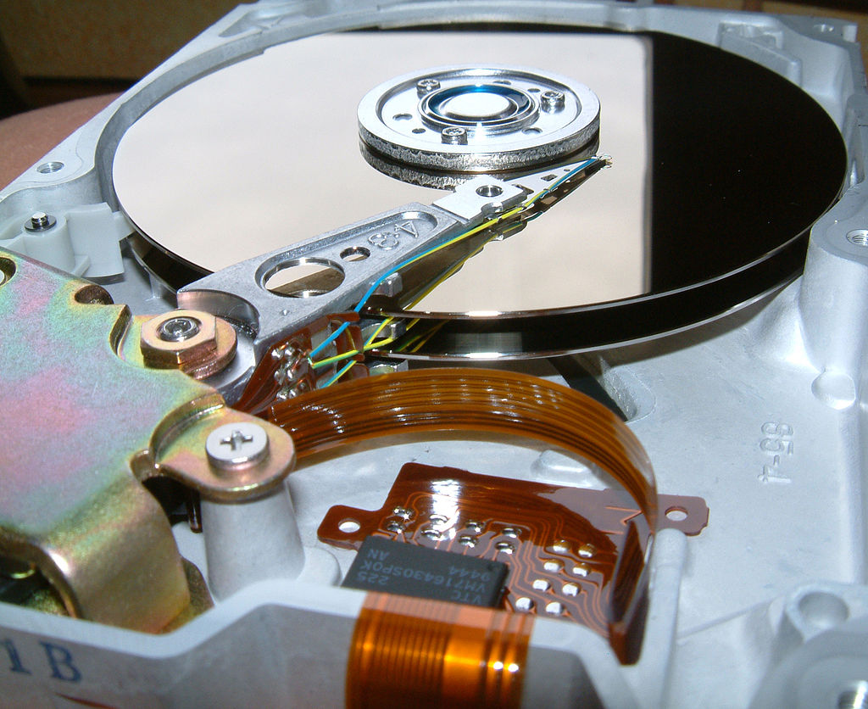
Mechanics of HDDs
Platters: HDDs contain circular, flat disks called platters. These platters are typically made of aluminum or glass and coated with a magnetic material. Data is stored on these platters.

Slide 3
Mechanics of HDDs
Read/Write Heads: An actuator arm with tiny read/write heads moves across the surface of the platters. These heads are responsible for reading data from the magnetic material and writing new data onto it.

Slide 4
Mechanics of HDDs
Spinning Disks: The platters spin at incredibly high speeds, typically 5400 or 7200 revolutions per minute (RPM). Higher RPMs generally mean faster data access.

Slide 5
Data Storage: It's All About Magnetism
HDDs utilize magnetism to store data. Here's how it works:
Binary Representation: All the data on your computer is ultimately represented as sequences of 0s and 1s (binary code).
Magnetization: The platters are divided into microscopic regions. Each region can be magnetized in one of two directions, representing a '0' or a '1'.
Reading and Writing: The read/write head magnetizes these regions to store data (writing). It also detects the existing magnetic orientations to read the data back.

Slide 6
How Your HDD Stores Information
HDDs use magnetic platters to store data in tiny 'bits' (0s or 1s).
Deleting a file just removes its entry from the "file table" (like the library catalog).
The actual data often remains on the platter until overwritten by new information.

Slide 7
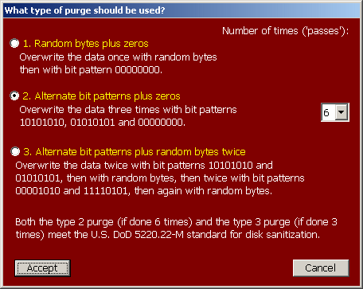
Method 1: Digital Paper Shredding: Overwrite for Erasure
Specialized software fills the hard drive with random data, sometimes multiple times.
Obscures the original data patterns, making recovery very difficult.
Common tools: DBAN (Darik's Boot and Nuke), KillDisk
Source

Slide 8
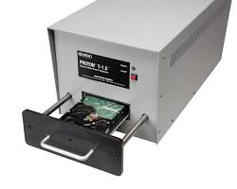
Method 2: Degaussing
Magnetic Mayhem
A powerful magnet disrupts the magnetic patterns on the platters.
Renders data permanently unreadable.
Fast but requires specialized equipment.

Slide 9
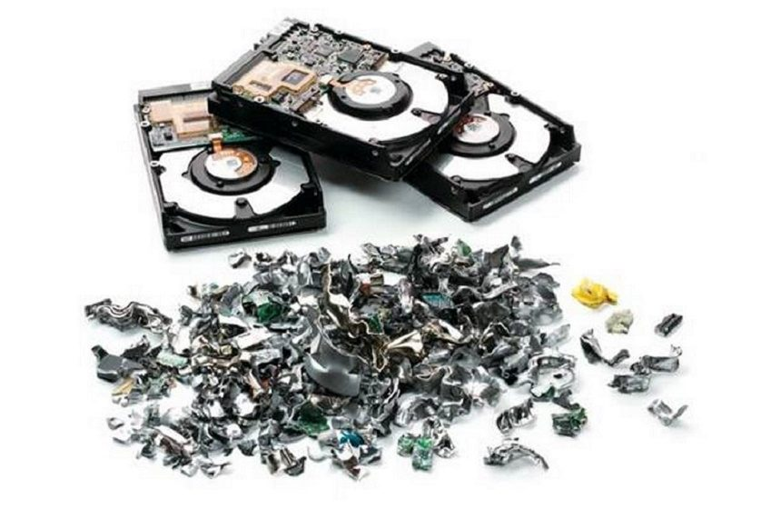
Method 3: Physical Destruction
When Overwriting Isn't Enough
Drilling, shredding, or incinerating the hard drive.
Ultimate data security but renders the drive unusable.

Slide 10
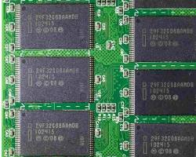
SSDs: A Different Challenge
Why Overwriting Isn't the Answer for SSDs
SSDs use different storage technology than HDDs – wear-leveling and TRIM commands complicate erasure.
Overwriting may not reliably hit every bit of old data.
Secure erase tools and manufacturer-specific software are often needed for SSDs.

Slide 11
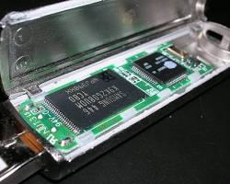
What is Flash Memory?
The Heart of SSDs: Flash Memory
Non-volatile memory: Retains data without power.
Found in SSDs, USB drives, memory cards, etc.
Uses "floating gate" transistors to trap electrical charges representing data

Slide 12
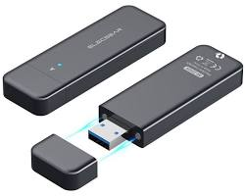
USB Flash Drive vs. SSD
Similar Technology, Different Goals
Both use flash memory, but are optimized differently
USB Drive: Portable, smaller transfers, generally slower speeds.
SSD: Internal computer storage, prioritizes maximum speed, capacity, and handling demanding workloads.

Slide 13
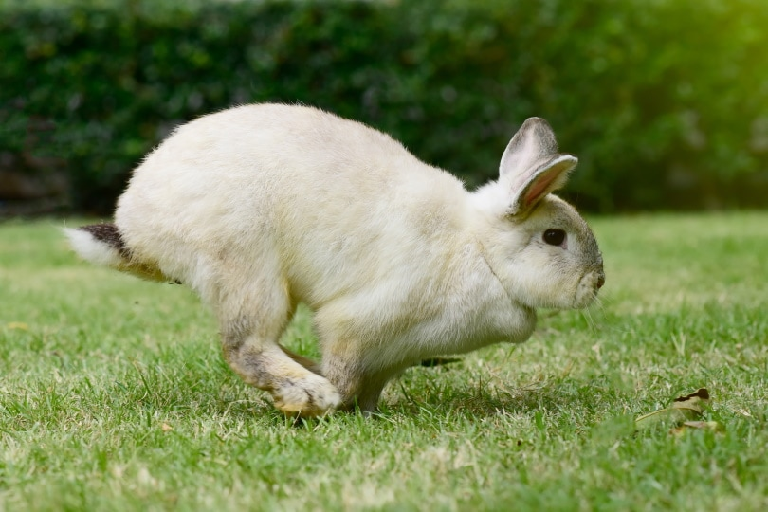
SSD Cache: The Speed Boost
SSDs often have DRAM cache for temporary storage of frequently accessed data.
Acts as a high-speed buffer, improving performance, especially with repetitive tasks.

Slide 14
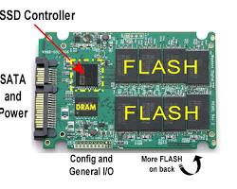
The Brains of the Operation: SSD Processors
SSDs Have Their Own Processors
Controllers manage complex tasks critical to SSD operation:
Wear leveling: Distributing writes for even wear of flash cells.
Garbage collection: Cleaning up space from deleted data.
Error correction: Protecting your data's integrity.

Slide 15
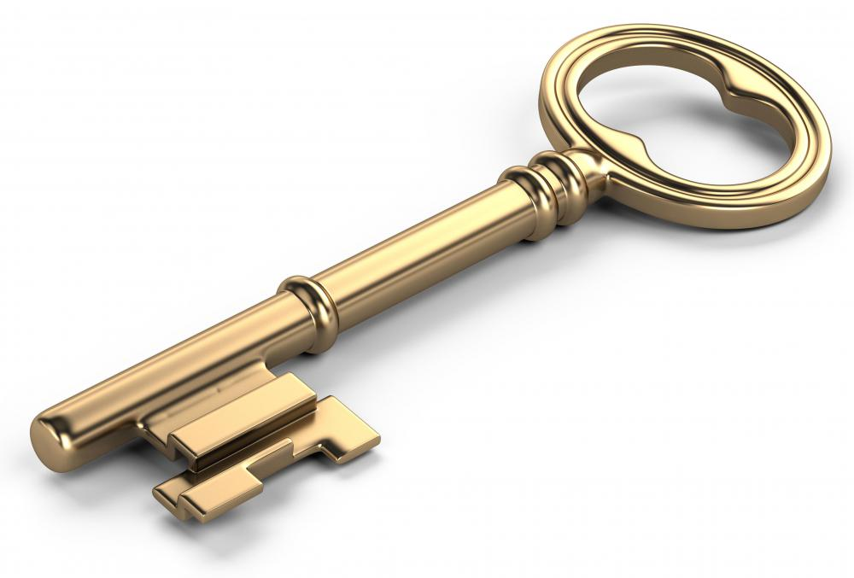
SEDs: Built-in Data Security
SSDs have hardware-based encryption.
Makes data unreadable without the correct key.
Protects sensitive information even if the SSD is stolen, but most importantly it allows you to securely erase your drive for resell.

Slide 16

Filesystems: The Unsung Heroes of Data Storage
Imagine a library without a filing system – books piled haphazardly, impossible to find anything! Filesystems are the librarians of the digital world, meticulously organizing and keeping track of all your data on hard drives and storage devices.

Slide 17
The Essential Roles of a Filesystem
Stores and organizes files and folders on a storage device
Assigns unique filenames and tracks where data resides on the drive
Manages metadata (file size, creation date, permissions)
Controls access and security to different types of data

Slide 18
Choosing the Right Filesystem for the Job
Popular Filesystems and Their Applications
FAT32: Older but widely compatible, ideal for USB drives and cameras (limited file size)
exFAT: Modern successor to FAT32, supports larger files, suitable for flash drives and cross-platform use.
NTFS: Windows' default choice, robust features like journaling and permissions, excellent for internal hard drives.
Ext4: Popular Linux filesystem, known for reliability and performance, not natively readable by Windows.

Slide 19
Journaling: Keeping Track of Changes
A journal records the modifications a filesystem intends to make to files before they are written to the disk.
In case of a sudden power outage or system crash, the journal helps determine data consistency and enables recovery.

Slide 20
Journaling: Pros and Cons
Journaling Filesystems:
Offer better data integrity and crash recovery
More secure against data corruption
Might have a slight performance overhead due to the extra write operation for the journal.
Non-Journaling Filesystems:
Simpler and faster for basic operations
Less overhead
Increased risk of data corruption if a crash occurs during write operations.

Slide 21

Why Cameras Ditch the Journal
Cameras prioritize fast write speeds and compatibility for viewing photos on different devices.
While losing some photos due to corruption is frustrating, it's less damaging than crashing your entire operating system.
Windows systems handle complex tasks. Journaling offers vital protection against crashes corrupting critical files.

Slide 22
Understanding Partitions in a Hard Drive
Partitions are distinct sections of a hard drive.
Think of them as separate 'containers' on a disk, each formatted with a specific file system like NTFS, FAT32, or ext4.
Organizational Structure:
Partitions can help organize data by type or category, like separating system files from user data.
Efficiency:
Smaller partitions can lead to less fragmentation and potentially faster access times for data.
Dual-Booting:
Dual-booting where each OS resides on a separate partition, allowing users to choose an OS at startup.

Slide 23
From Partitions to Volumes
Definition:
A volume is a storage area with a file system, which the operating system can access as a single drive, even if it spans multiple partitions or disks.
Single Accessible Unit:
Volumes make one or more partitions appear as a single drive letter in Windows or a single mount point in Unix/Linux.

Slide 24
Linking Partitions and Volumes
Partitions serve as the foundational elements of a hard drive's structure. They can be individually formatted and used as separate units for storage. However, when combined, they can also be recognized by the operating system as a singular logical volume. This allows for more flexible and efficient use of the storage space on the drive.

Slide 25
Combining Partitions
There are various scenarios where it may be advantageous to combine multiple partitions into a single volume:
Expanding Storage: When a partition runs out of space, expanding it into an adjacent unallocated partition can provide additional storage without the need to reformat or move data.
Pooling Free Space: In systems with multiple drives, partitions from each drive can be combined to create a volume that pools their free space, making it appear as one large drive to the operating system.
Redundancy and Performance: Certain types of volumes, like those in RAID arrays, can span across partitions on multiple drives for increased redundancy or performance.

Slide 26
Volume Management
Operating systems come equipped with tools to manage the creation and administration of volumes:
Windows Disk Management: This graphical tool allows users to create, resize, and delete partitions and volumes, and to format them with various file systems.
Linux Logical Volume Manager (LVM): LVM is a more flexible system for volume management. It allows for logical volumes to span across multiple physical partitions or disks, and even allows for resizing volumes on-the-fly, without the need for unmounting or downtime.

Slide 27
Homework – Wikpedia!
Disk partitioning
Logical Volume Management
Storage spaces
RAID
Understand partitioning first. Then LVM & Storage Spaces are abstractions for volumes commonly done in software. RAID is done either in software or hardware for redundancy. Make sure to have read these before this afternoon. :)

Slide 28
LAB
Follow along with Steve on installing Debian.
We’ll chat about partitioning, packages and installing Debian.
The Zoom video will be recorded and shared before the end of class so you’ll have lots of time to replay the video before the afternoon session.

